Slide 1
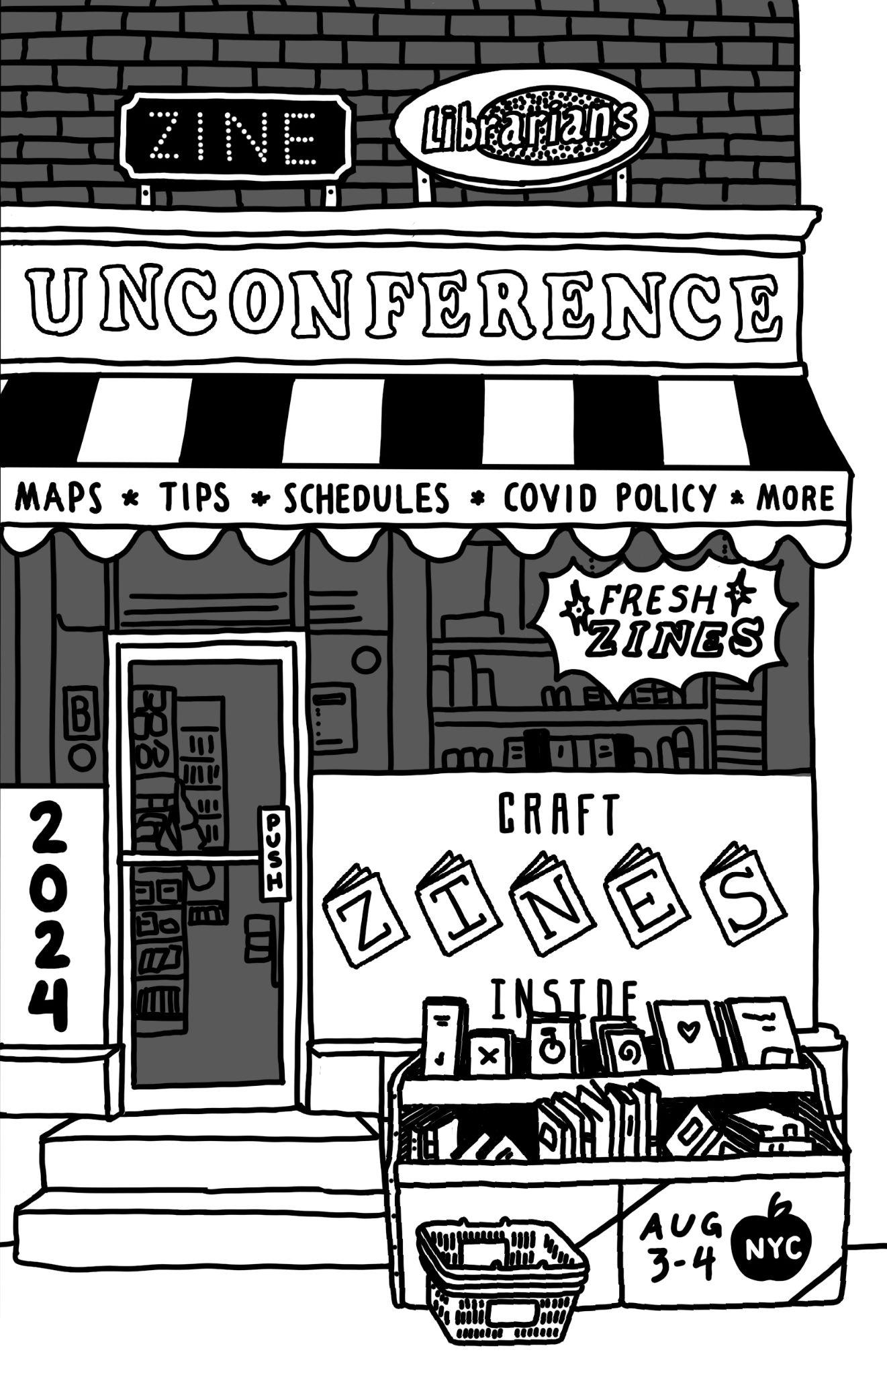

Slide 2
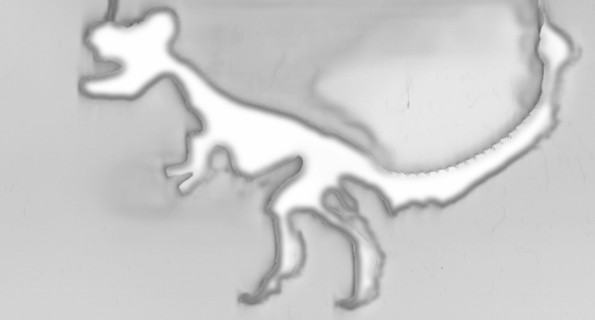




Welcome
#ZLuC2024
@zineluc
Dear You,
Thanks for attending Zine Librarians Unconference 2024. It turns out that organizing an unconference is hard. Who knew? But it’s also fun, and it’s made all the more so when you have dream collaborators. Gina, Lauren, and Jenna ended nearly every meeting with a virtual group hug. The six working groups (social media, tech, extracurriculars, travel grant, programming, and accessibility) were also exceptional collaborators. xo Jenna, Gina, and Lauren
We are beyond grateful to the following folks at NYU:
External Engagement Team, Endpoint Computing Services, and Libraries' Senior Leadership have been super helpful and supportive, and they provided financial backing with coordinating:
- Reserving spaces
- Catering
- Classroom Technology & Wifi (special shoutout to Endpoint Computing Services and Campus Media)
- CART & accessibility support
- Facilities maintenance and cleanup
- Housing payment and coordination
- And many other little things over the last nine months of planning!
Photo Policy
Lanyards will tell you
Photos okay
Ask first
No photos
This zine was created mostly by Holly Wilson, Lex Turnbull, and Hanson Coleman (cover art!) in July 2024 in Brooklyn, Atlanta, and Rhode Island, but let’s call the pub location NYC and give it a CC0 license. Please hold Jenna Freedman responsible for any parts of the zine you have issues with.
🍉
2

Slide 3
Table of contents
2 Welcome
3 Contents (this page right here!)
4 Friday Night Activities
5 Saturday Zine Reading
6 Sunday Tours
7 NYU Insider Tips
8 Area map showing Bobst and dorm
9 Protest Info
10 Saturday Schedule
11 Sunday Schedule
12 NYU Boycott List
13 Coffee/tea/restaurant recs - QR code with area
activities and attractions
14 Bookstores (mapped at QR code on page 13)!
15 Code of Conduct
16 Care Team contact info
17 COVID policy
19 Notes
20 ZLuC 2024 MadLibs
3

Slide 4
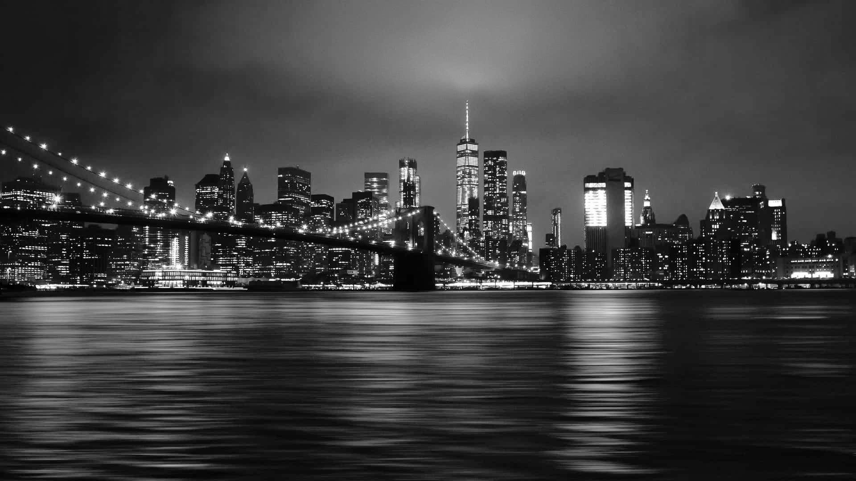
Friday Night Activities
These are not organized by the organizers and will happen only if you make them happen. We’re suggesting meetups happen at 8pm. Bring a zine so people can recognize you!
Karaoke at Karaoke Sing Sing, 81 Avenue A
Drinking without the singing Bookclub Bar, 197 East 3rd St.
Drinking without the alcohol Hekate Cafe & Elixir Lounge, 167 Avenue B
We also recommend buying (whatever you like) and hanging out in the dorms and playing MadLibs or cards. The dorms are where a lot of the connections and community building happen!
4

Slide 5


Join us at P&T Knitwear (180 Orchard st.)
from 6-8pm for a reading followed by a zine swap! All welcome!
What to expect:
This event will start at 6pm, but P&T is open normal hours (12 noon to 8pm), so you can be early and make yourself comfortable
Six folks will be reading from their zines starting at 7:15pm
A communal zine swap will take place after the readings finish
About the space:
150 is the comfortable capacity limit and of those 150, they can seat about 100
There is a cafe inside the bookstore that serves coffee, tea, light snacks, sandwiches and more
There are no stairs to enter the space, but seating is amphitheater style, so wheelchair accessible seating is limited
P&T is a bookstore and podcast studio that provides physical and virtual spaces to build community around storytelling
Saturday Zine Reading
5

Slide 6

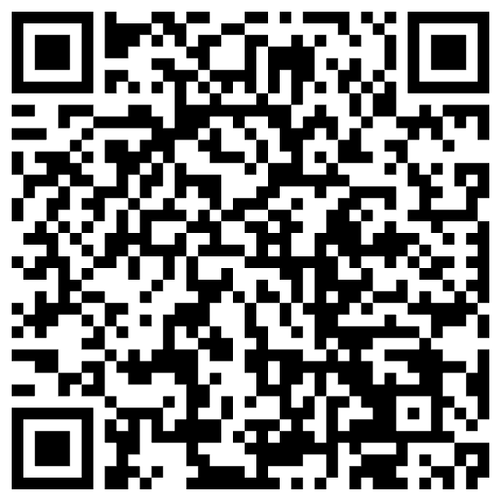
Sunday Tours
Sunday, Aug 4th @ 5:30pm
Register at ZLuC
Barnard Zine Library - This collection strives to please everyone from the most controlled librarians to the wildest zine-makers.
Interference Archive - The mission of Interference Archive is to explore the relationship between cultural production and social movements. This work manifests in an open stacks archival collection, publications, a study center, and public programs including exhibitions, workshops, talks, and screenings, all of which encourage critical and creative engagement with the rich history of social movements.
MoRUS - Museum of Reclaimed Urban Space showcases an often untold version of New York City history through photography, videography, authentic artifacts, and documents.
Pratt Institute Library - Located in the neighborhood of Clinton Hill, in a handsome 1896 landmark building with interiors by the Tiffany Glass & Decorating Company. Collections and services are focused on the visual arts, architecture, design, creative writing, and allied fields.
6

Slide 7
NYU insider tips
Outdoor seating options:
Washington Square Park serves as NYU's quad, but it's a public park, so there's lots to see and do, and plenty of seating! Check out the fountain at the center of the park.
Sasaki Gardens located between 3rd Street and Bleecker. Enter the park through the faculty housing driveways (large white buildings behind Bobst). Best views of the park are in North Reading Rooms, so please visit the even floors of Bobst to locate a seat and birdwatch!
Designated eating areas include the 5th Floor south side of Bobst and the Lower Level 1 lounge. You can also eat on the catwalks on each floor, but please remember to deposit your trash in the provided bins!
Restrooms are on every floor on the southside, both east and west of the building. Accessible and gender-neutral bathrooms are located on the 5th Floor Lower Level 2 (use the two elevators on the east side--closest to the statue of Bobst to get to the lower levels)
Water fountains are located throughout the building near the restrooms
Vending machines for snackies are located on Lower Level 1. The machines take cash and card. There is also a microwave for warming food up.
ZLuC organizers have put together a quiet space in Room 613 and a craft/zine making space in 411. There's also a Sensory Space on the 1st Floor, southwest side of the building, if you need a lowly lit and very quiet space
Wi-Fi will be available to all participants
7

Slide 8
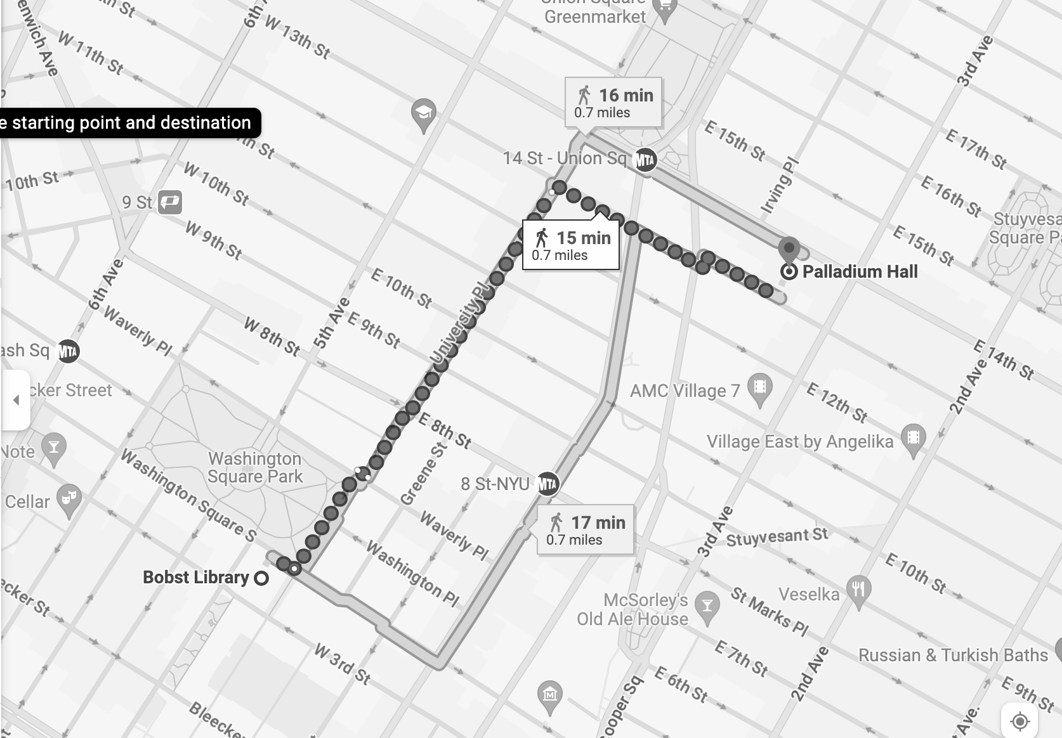

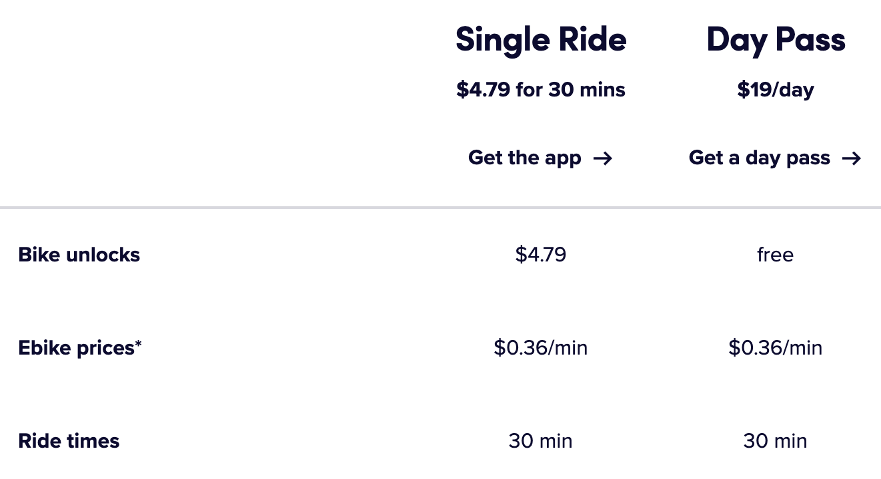
DORM
ZLuC
Fuck banks, but still, consider renting a CitiBike to get around.
¯\_(ツ)_/¯ https://citibikenyc.com
BYO Helmet!
8

Slide 9
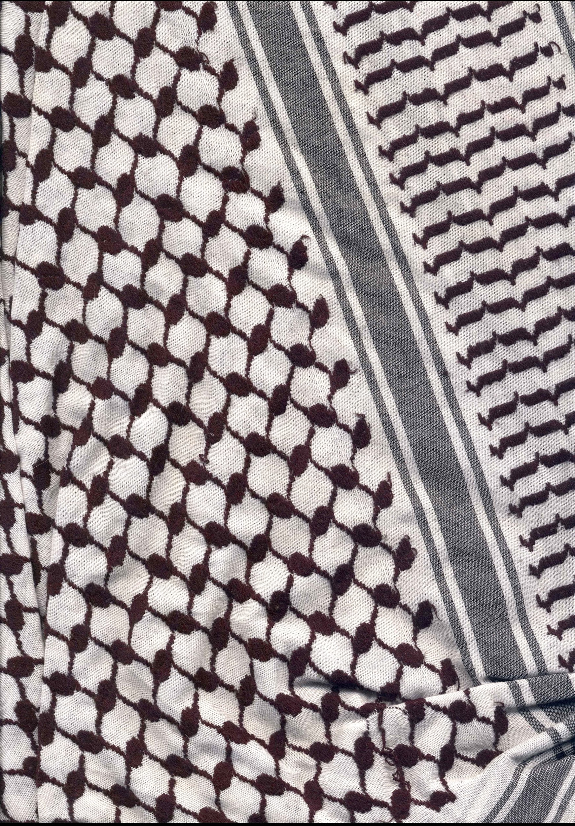
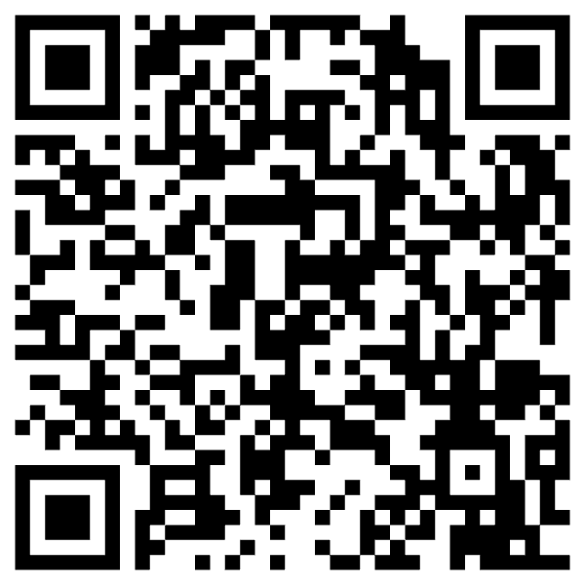
If you can’t sleep at night unless you’ve screamed “FREE FREE PALESTINE” at least once during the day, here are a few tips on how to fight genocide while you’re in NYC.
At press time, we don’t know about specific protests. Joe Catron updates this list daily —--------->
We recommend tuning
into these accounts:
Instagram: @nyu_sjp & @nyumsa
@protest.nyc @jvpny
Twitter: @taliaotg @protest_nyc @SpyderMonkey0_0
9

Slide 10
Saturday, August 3, 2024
Note:A quiet room (613) and a craft/zine-making room (413) will be available all day.
9-9:30am: Breakfast and welcome
9:30-10:15am: Opening plenary - 2nd Floor North Reading Room
10:15-11:30am: Session 1
1A- Academic libraries lightning talks (room 745)
1B- Collecting & organizing lightning talks (room 743)
1C- Collecting and archives panel (room 619)
1D- MarcEdit workshop (room 617)
11:30-11:45am Break (2nd Floor North Reading Room)
11:45-1pm Session 2
2A- Outreach and workshops lightning talks (room 745)
2B- Radical collecting lightning talks (room 743)
2C- Latine Zine Futures panel (room 413)
2D- Building community & subverting educational institutions panel(room 619)
1-2pm Lunch (2nd Floor North Reading Room)
Zine lunch provided: Interest Group, Introvert Time &/or Mingle
Interest Group: Black Zines & Zinesters (room 743 or outdoors)
2:00-3:15pm Session 3
3A- Punk Music in Libraries panel (room 743)
3B- Workshop comparing MARC, ZAPP and ZineCore zine cataloging decisions (room 745)
3C- Interest groups: Breakout discussion sessions on Instruction
3D- Pre-recorded session viewing: Lawrence Byrne, Charlie Anne, Lily De La Fuente, Arya Natarajan, and Noam (room 413)
3:15-4pm Wrap-up Saturday sessions - 2nd Floor North Reading Room
6-8pm Zine reading at P&T Knitwear, 180 Orchard Street
Readers include: Amber McCrary, Kika Van Robays, Jonathan Tuttle, Jennifer LaSuprema, Pau Venadito, Alice Wynne, and Your Name Here!
10

Slide 11
Sunday, August 4, 2024
Note:A quiet room (613) and a craft/zine-making room (413) will be available all day.
9-9:30am Coffee and tea - 2nd Floor North Reading Room
9:30am-10:15am: Opening plenary
10:15-11am Session 4: Interest groups
4A: Libraries by Type (Public, Independent, Archives) (Find a spot in 745, North Reading Room, or outdoors)
4B: Cataloging (room 743)
4C: Collecting (room 619)
4D: Outreach and Programming (room 413)
11:15-12pm Session 5: Introduction to the Zine Librarians Code of Ethics (2nd Floor North Reading Room)
This session will offer a history of the Zine Librarians Code of Ethics and introduce plans for updating this classic resource. Sections and interest areas will be created, and attendees will sort into working groups.
12-1pm Lunch (2nd Floor North Reading Room)
Zine lunch provided: Interest Groups, Introvert time and/or Mingle
Interest Groups
De-centering the US (room 743)
Zines for Youth (room 619)
Zines & Archives (room 413)
1-2:45pm Session 6: Zine Librarians Code of Ethics Working Groups *Working Groups will be created and assigned rooms
2:45-3pm Break
3-3:45pm Closing Plenary (2nd Floor North Reading Room)
5:30pm Zine Library Tours (optional): Please see
page 6 for locations and details
11

Slide 12
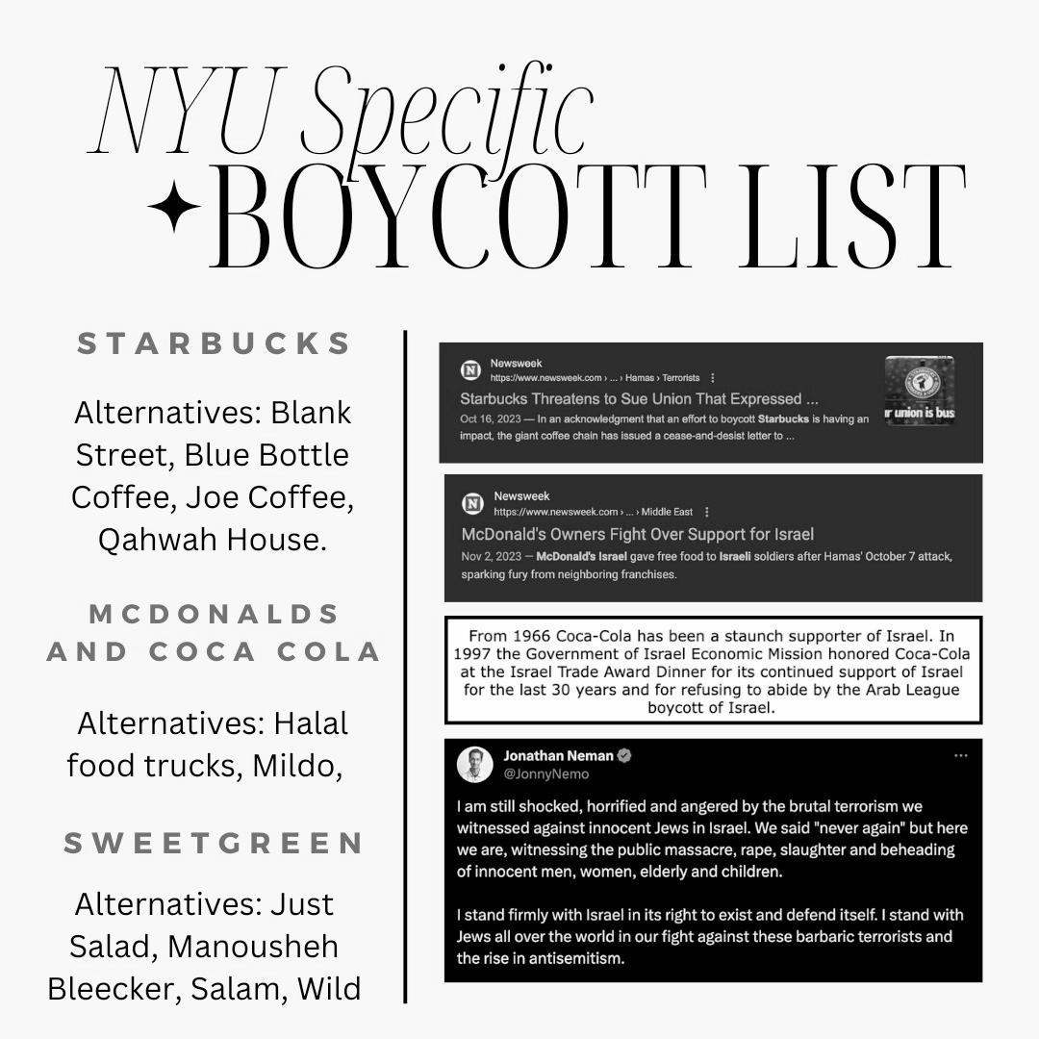
“If we, as consumers, target specific brands, then we can make a difference.
For those who believe it will not make a difference on Israel: ‘When Prophet Ibrahim was thrown in the fire, a little bird came with tiny drops of water to extinguish it. Other animals said 'What would your drops do of this huge fire?' The bird replied, 'On The Day of Judgement, Allah (SWT) will not asked me whether I manage to put out the fire or not. But Allah (SWT) will ask what I have done to stop the fire.’ “
NYUMSA (Muslim Student Association)
12

Slide 13



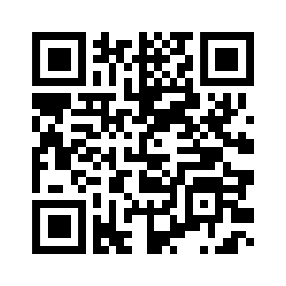




coffee / tea
restaurants
248 Mercer
I’m a map with lots of fun things in the area!
649 Broadway
BLANK STREET
688 Broadway
*budget=conscious suggestions
140 West 4th Street
*lower level - stair access only*
Mock meat and faux fish as Asian & Southern fare with vegan desserts.
41 E 11th St
Casual, stylish cafe with an artsy vibe serving creative vegan fare, desserts & smoothies.
jajaja
mexicana
63 Carmine Street
Modern Latin and Mexican vegan food, including tacos, gorditas, chile relleno, churros, flan, and brunch.
119 Avenue A
Compact, all-veggie fast-food serving popular burgers in white-tiled space.
118A Eldridge St
Bare-bones spot supplying dumplings, steamed buns, and more, plus bubble tea. *has outdoor seating*
13

Slide 14


book
stores
Alabaster Bookshop, 122 4th Ave.
Bluestockings, 116 Suffolk St.
Bureau of General Services–Queer Division (inside LQBTQ Community Center) 208 W. 13th St.
Forbidden Planet, 832 Broadway
Kinokuniya 1037 6th Avenue of the Americas (Bryant Park) (Japanese book and stationery story)
Mercer Street Books & Records, 206 Mercer St.
Namaste Bookshop, 2 W. 14th St.
Strand Bookstore, 828 Broadway
Sweet Pickle, 47 Orchard St.
Three Lives & Company, 154 W. 10th St.
14

Slide 15
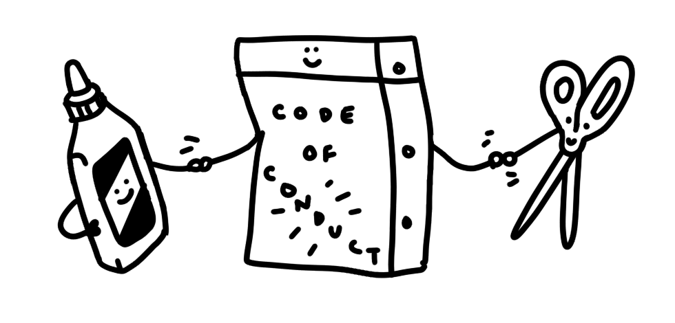
ZLuC ‘24
Code of
Conduct
The Zine Librarians unConference (ZLuC) is a safer space, which means that it is intended to be a welcoming, engaging, and supportive environment free of oppressive actions, behaviors, and language. Participants are asked to consider how their language and behavior impacts others in attendance.
Harassing or abusive language or behavior will not be tolerated at ZLuC, including but not limited to: Racism, sexism, classism, ableism, homophobia, transphobia, misogyny, all other forms of discrimination, sexual harassment, stalking, intimidation, inappropriate physical contact, disruptive or disrespectful behavior, and any action or language that makes other participants feel unwelcome or unsafe. Participants asked to stop any harassing behavior are expected to comply immediately.
Should an issue arise with a participant before the event, ZLuC organizers will listen to concerns and attempt to find a non-carceral solution that is in the best interests of the community and the event being a safer space.
15

Slide 16

ZLuC organizers reserve the right to limit attendance to the event for any reason.
Should an issue arise with a participant during the fest, ZLuC organizers will be available to mediate on-site and attempt to find a solution. ZLuC organizers reserve the right to ask any participants who are violating the safer space policy to change or address their unsafe behavior or language, or to leave the event. If you are being harassed, notice that someone else is being harassed, or have any other concerns, please notify one of the ZLuC organizers immediately.
We expect participants to follow these rules at all ZLuC event venues, including social events.
❤ ❤ ❤ ❤ ❤ ❤ C A R E T E A M ❤ ❤ ❤ ❤ ❤ ❤
You can notify one of these people if the Code of Conduct has been violated, or you want help navigating a situation.
Destinee Thom ♡ Kelly Wooten ♡ Lauren Kehoe ♡ Violet Fox ♡
Call or text for Care! (646) 631-2755
16

Slide 17
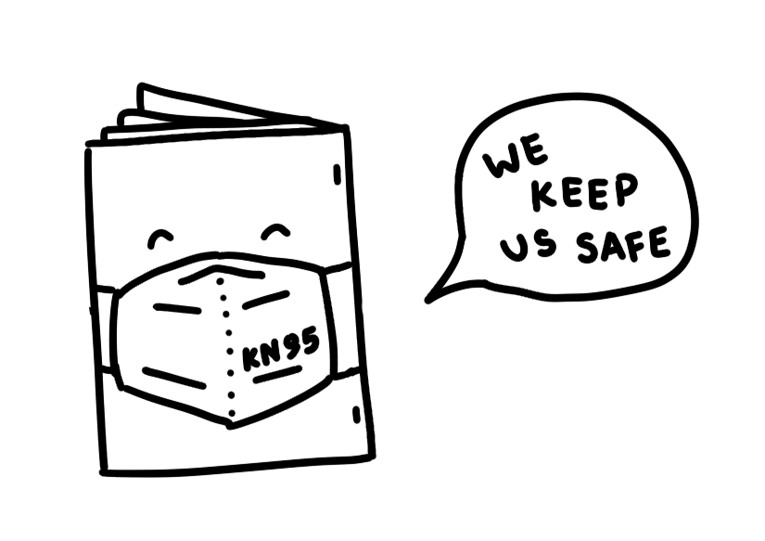
ZLuC ‘24
COVID
Policy
Masking:
Air quality & space:
Amid an ongoing airborne pandemic, we strongly encourage mask usage during indoor portions of the unconference.
Mask usage will be optional outdoors at ZLuC. Some presenters at the unconference may prefer that you mask, and we ask that you respect their wishes.
Please note: *Free KN95 masks will be made available to attendees upon arrival*
Whether indoors or outdoors at the unconference, please be mindful of your physical distance to other attendees.
At Bobst Library, windows can’t be opened. However, doors can be opened to increase air flow. There are three air filters that are mobile and available; one remains in the library’s sensory space. In addition, CO2 monitors will be used during indoor sessions to keep track of air quality.
17

Slide 18

Testing:
We keep us safe!
If possible, test for COVID before arriving on-site and upon returning home from the ZLuC.
If you test positive beforehand, or are experiencing symptoms of what could be COVID, please do not come to the unconference and risk infecting others, even if you think it might be “just a cold” or “allergies.”
If you test positive after the unconference, please email any of the unconference organizers and inform them of your positive status so they can inform other attendees. If you are unable to attend due to illness, your registration fees will be refunded upon request.
Our COVID policy is intended to keep ZLuC attendees healthy and to foster inclusivity, allowing all to enjoy the unconference with decreased risk of transmission. ZLuC organizers have the right to ask any
attendee violating our
COVID policy to adjust their behavior or leave the unconference for the sake of community care.
18

Slide 19
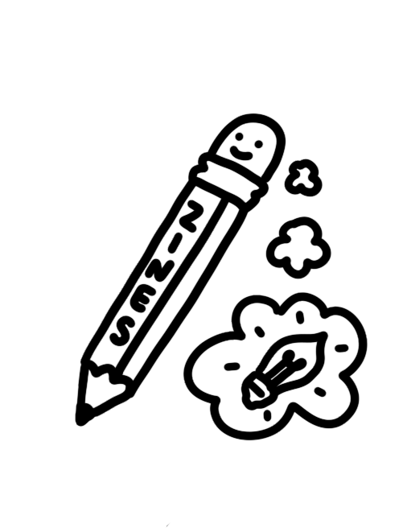

n o t e s !
19

Slide 20
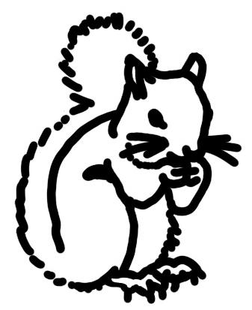

ZLuC 2024 MadLibs
1 adjective
2 place
3 adjective
4 adjective
5 adjective
6 profession
7 adjective
8 adjective
9 verb
10 plural noun
11 gerund (-ing verb) _________
12 gerund (-ing verb) _________
13 gerund (-ing verb) _________
14 adjective
15 adjective
16 adjective
17 animal
18 place
19 adjective
20 adjective
So, I’m attending the 1 Zine Librarians unConference in 2 . I’m feeling
3 and 4 , and hoping to meet some 5 6 s.
From looking at the 7 schedule, there is a lot to learn, and I hope I don’t get 8 .
There are a lot of things to 9 in NYC, too! In Washington Square Park, people and
10 are 11 , 12 , and even 13 !
There is a lot of 14 nature in the park, too, so take a 15 walk around and see if you can find any 16 17 s.
When I get back home to 18 ,
I hope to tell my 19 friends
all about the
20 time I had at ZLuC 2024!

